Slide 1




Slide 2



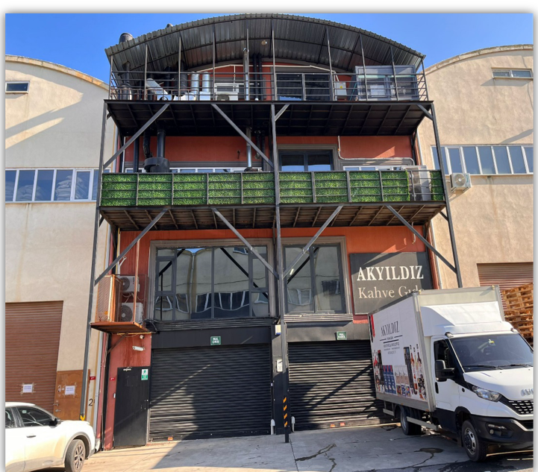
ABOUT US
2,600 m2 Closed Production Area
FRESH Production Made to order
Production by Applying Profile Roasting Technique with Latest Technology PLC Controlled Machines
12 Categories > 350+ Products
100,000 Capsule Coffee Production Capacity per Day
We have Halal, ISO, FDA and BRC FOOD Certificates

Slide 3
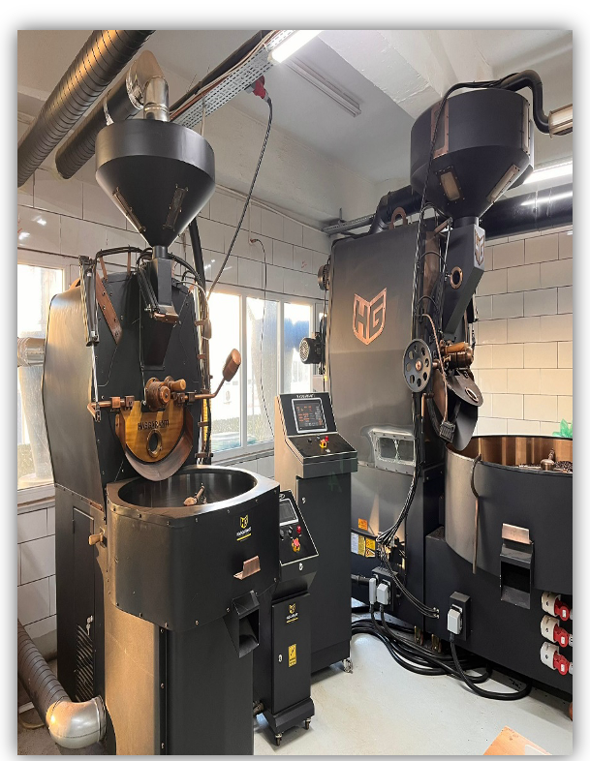



What Sets Us Apart
We bring the Freshest Coffee to our customers by producing on order.
Our Roasting Technology;
Standard production is always achieved with the latest technology PLC controlled profile roasting.
In Europe, coffee beans are roasted homogeneously with hot air, not with the traditional roasting method, which is thought to have a carcinogenic effect..

Slide 4




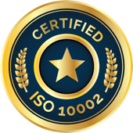
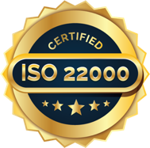
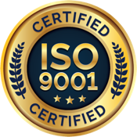
We are one of the few companies certified by both the FDA and BRC Food.

Slide 5
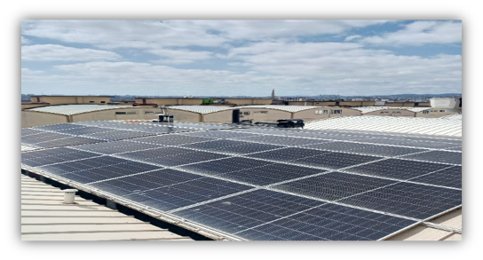
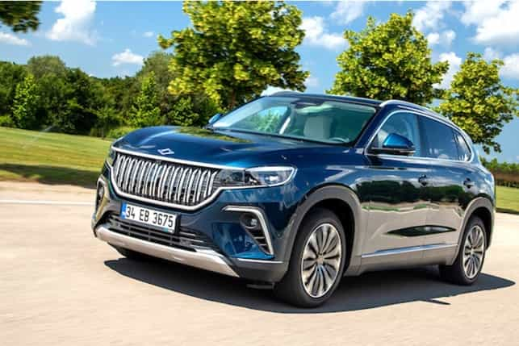


Focusing on the Green Factory concept, we installed a Solar Power Plant (SPP) on the roof of our factory, generating all of our electricity from the sun. In addition to eliminating our energy costs, we will also prevent 17.5 tons of CO2 emissions annually.
We have begun converting our company’s fossil-fueled vehicles to environmentally friendly electric ones. This transition has resulted in a 90% cost saving and has prevented 11.6 tons of CO₂ emissions annually. We will soon complete the conversion of all our vehicles to electric models.
We're also switching to recyclable packaging for our products. Our aluminum coffee capsules have an 80% recycling rate!

Slide 6
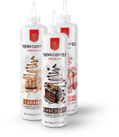









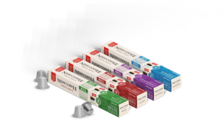
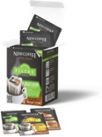
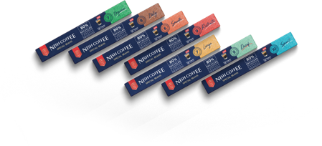

CATEGORIES & PRODUCTS
Aromalı Filtre Kahveler
Organik Kahveler
Espresso Çekirdek Kahv.
Pratik Filtre Kahveler
12
KATEGORİ
350+ ÜRÜN
12
KATEGORİ
350+
ÜRÜN
Filtre Kahveler
Şuruplar
Kafeinsiz Kahveler
Baz İçecekler
Kapsül Kahveler
Toz Karışım İçecekler
Aromalı Kapsül Kahveler
Türk Kahveleri

Slide 7
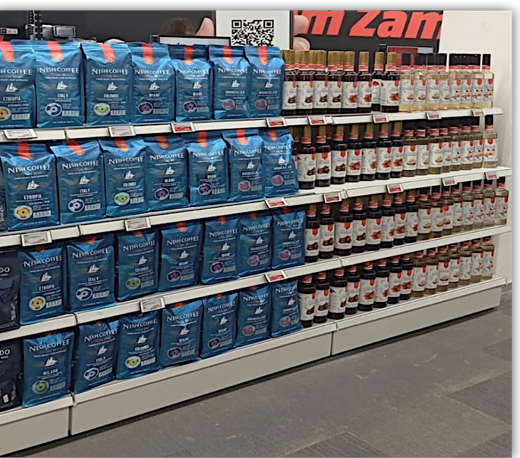
SOME OF OUR CUSTOMERS
We are the first company to have a vendor agreement in the coffee category on Amazon.
Fresh Market
Media Markt
Teknosa
Onur Market
Happy Market
Sarıyer Market
Şanlık Market
Acarlar Market
İdris Bakkal
HORECA

Slide 8
GLOBAL TRADE
Rusya
Azerbaycan
İngiltere
Amerika
Suudi Arabistan
Dubai
Mısır
Gürcistan
Bulgaristan
Irak
İran
Kıbrıs
Mauritus
POLAND
BULGARIA
UNITED
KINGDOM
AZERBAIJAN
IRAQ
USA
MOROCCO
RUSSIA
SAUDI ARABIA
IRAN
BRAZIL
MAURITUS
SOUTH
AFRICA

Slide 9

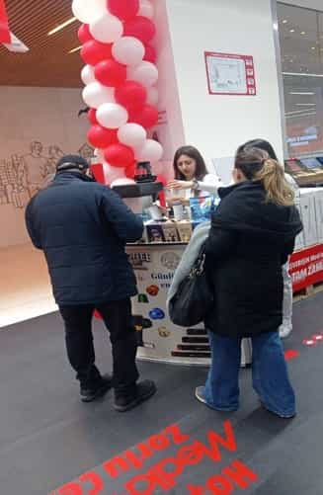
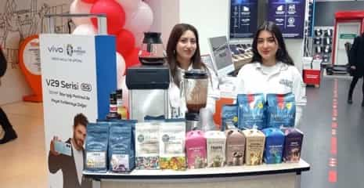
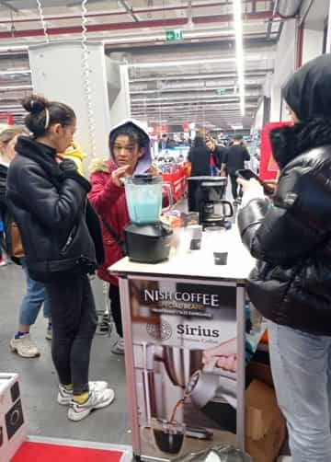
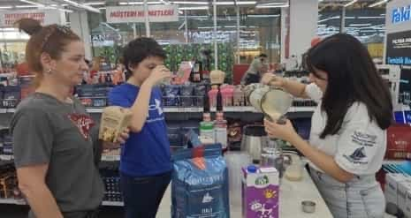
IMAGES FROM OUR FIELD OPERATIONS AT MARKTMEDIA

Slide 10
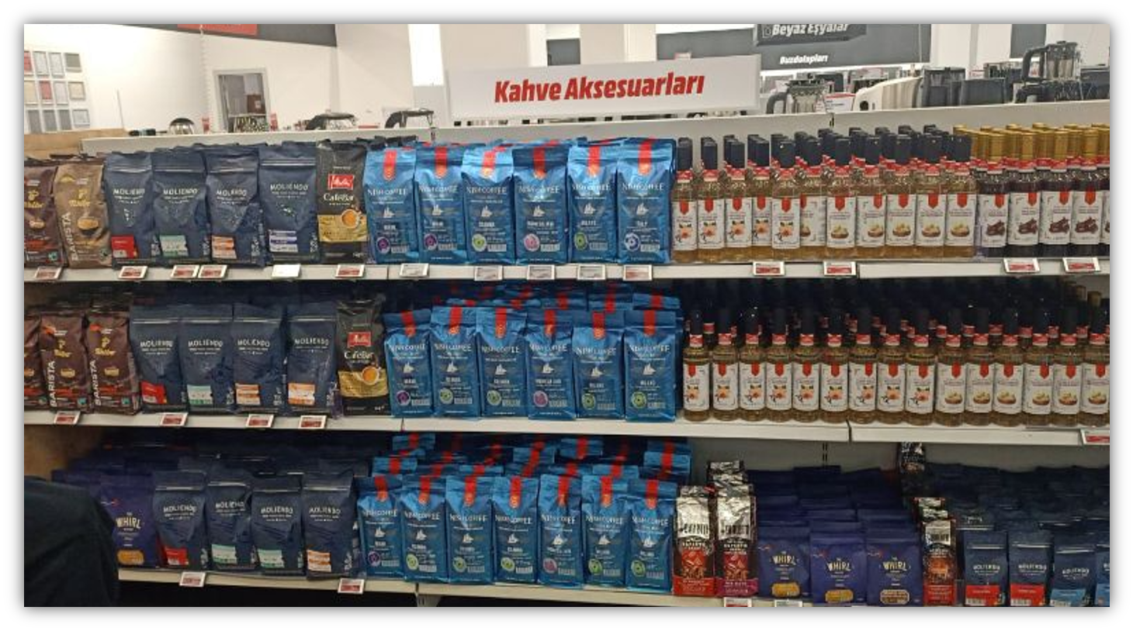
OUR AISLES AT MEDIAMARKT TECHNOLOGY STORES
We took our place in the 101 MediaMarkt section for coffee lovers.

Slide 11
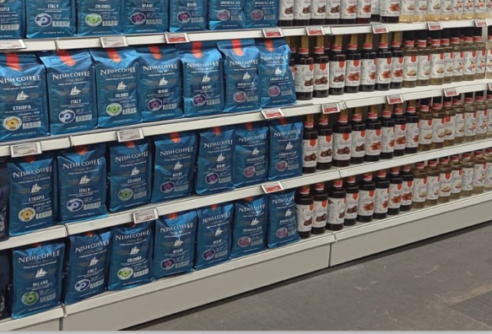

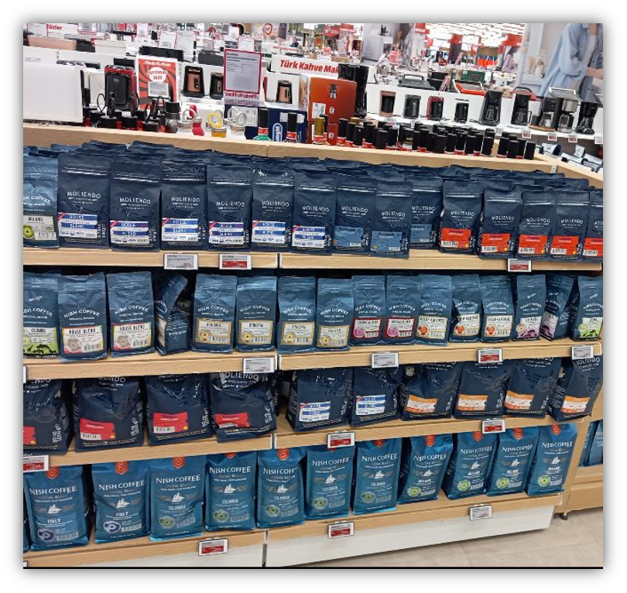
TECHNOLOGY MARKETS MEDIA MARKT - OUR DEPARTMENTS
We took our place in the 101 MediaMarkt
section for
coffee lovers.

Slide 12
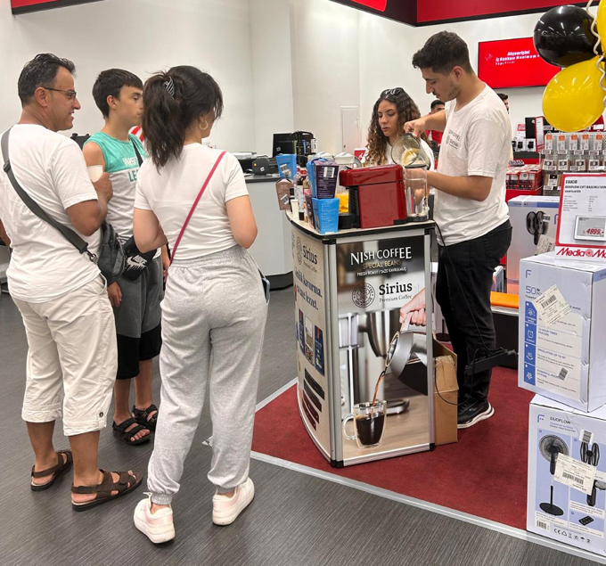
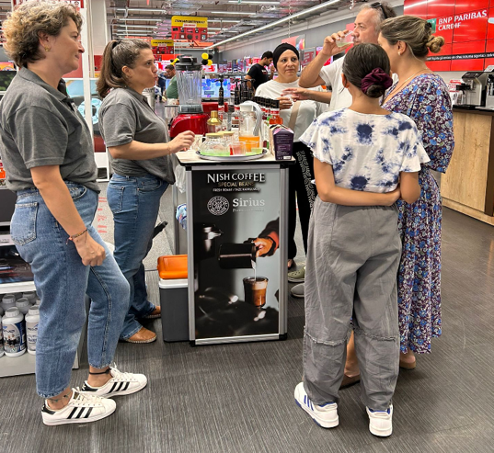

TECHNOLOGY MARKETS MEDIA MARKT – TASTING EVENTS
We are increasing our store visits with our tasting events.

Slide 13
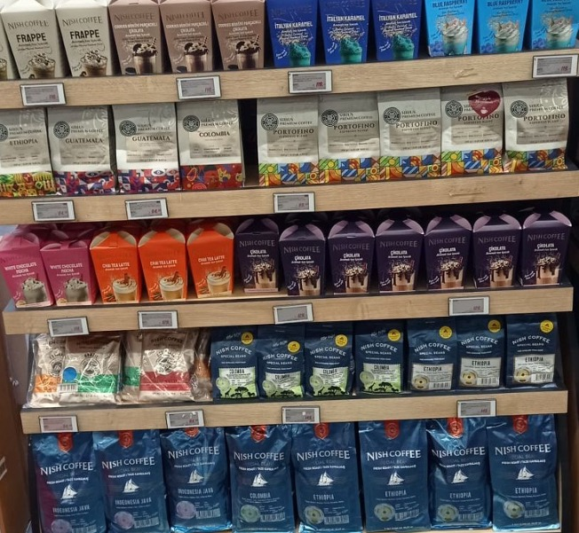
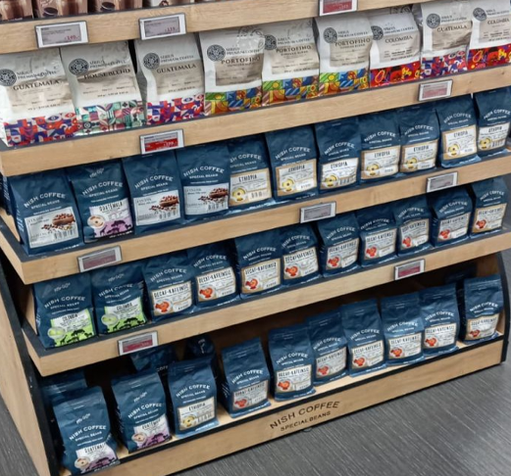
TECHNOLOGY MARKETS MEDIA MARKT – TASTING EVENTS
We are increasing our store visits with our tasting events.

Slide 14

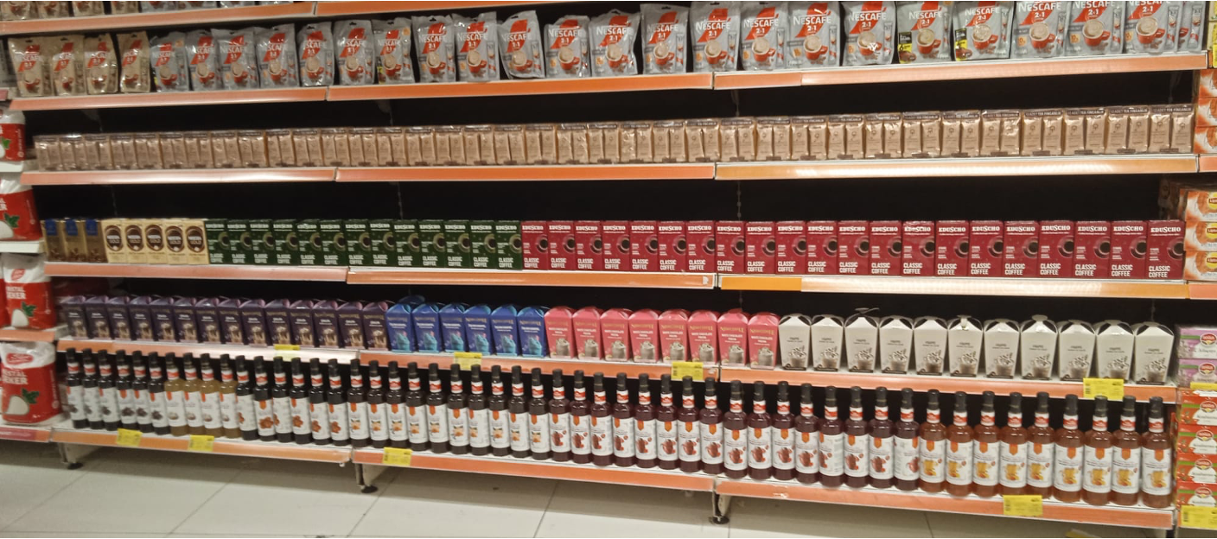
Local Market Sarıyer Market – OUR SECTIONS
We are located in all Sarıyer Market chains.

Slide 15
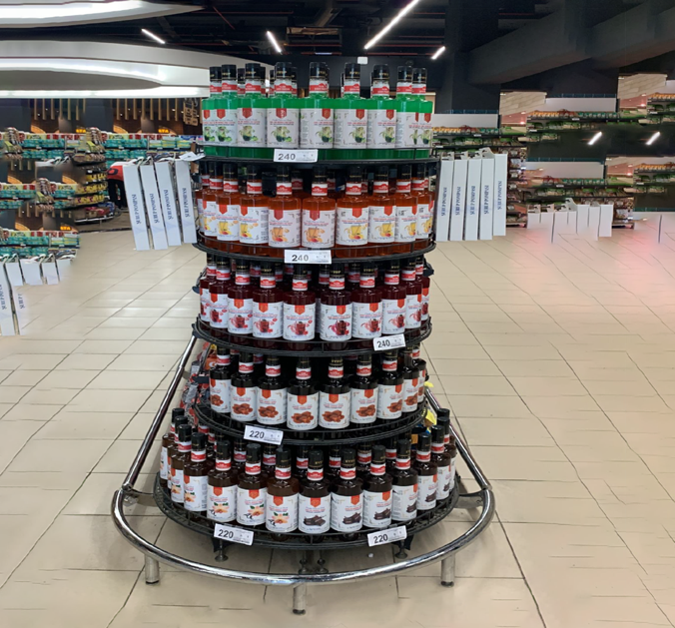
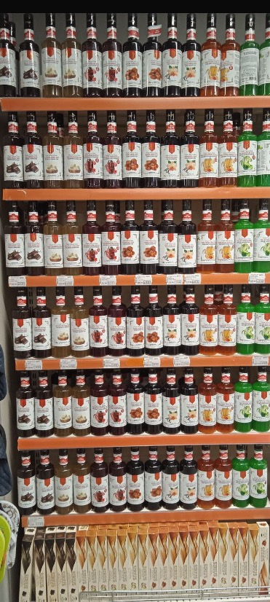
Local Market Sarıyer Market – OUR SECTIONS
We are located in all Sarıyer Market chains.

Slide 16
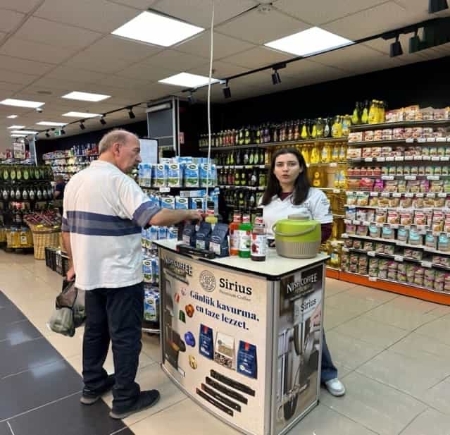
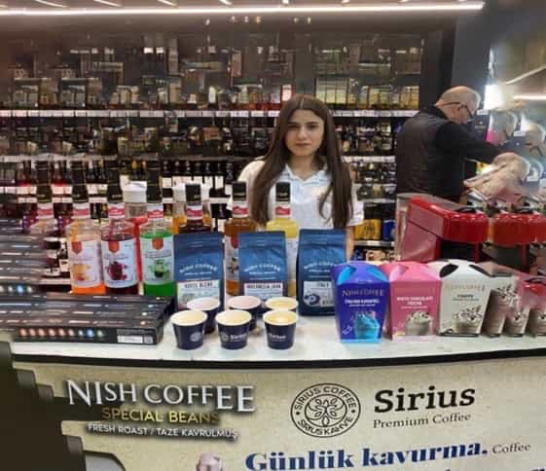
Local Market Sarıyer Market – OUR SECTIONS
We increased our sales rate by 65% ​​with our tasting events.

Slide 17
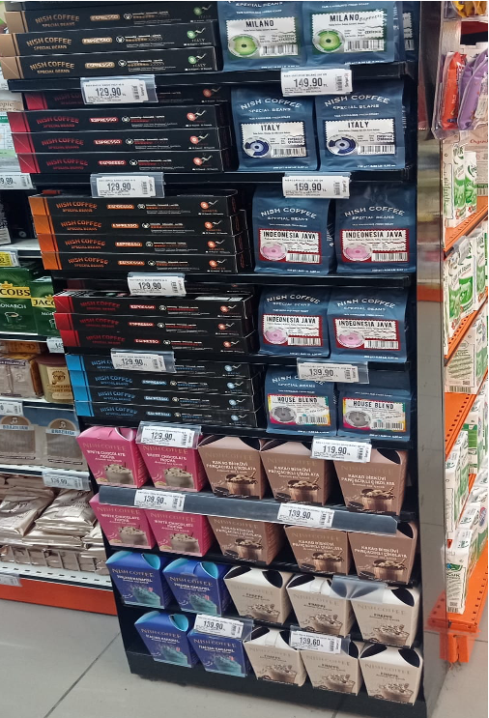
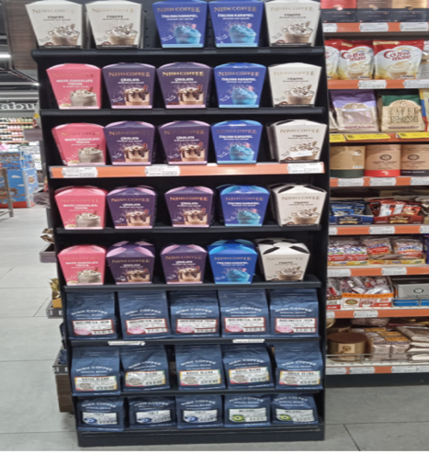

Local Market Happy Center – OUR DEPARTMENTS
We are located in 📍126 Happy Center stores.

Slide 18
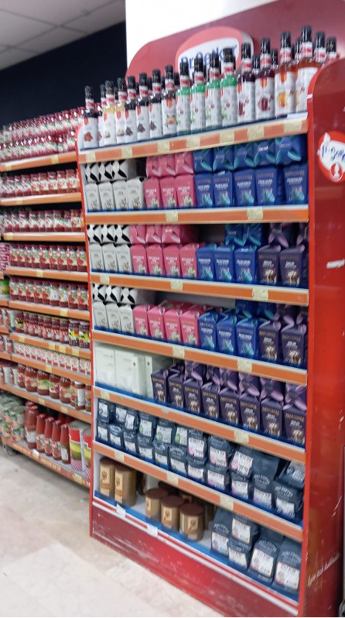
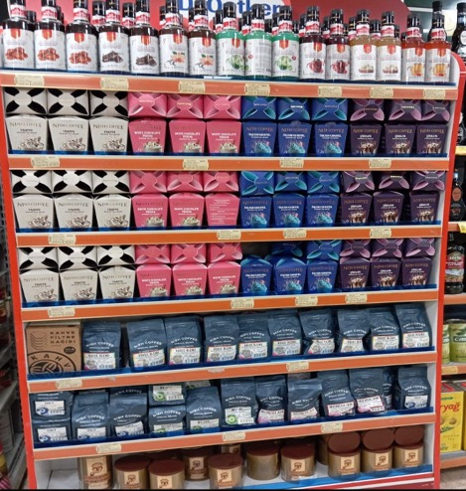

Local Market Onur Market – OUR SECTIONS
📍 We are located in all branches of Onur Market.

Slide 19
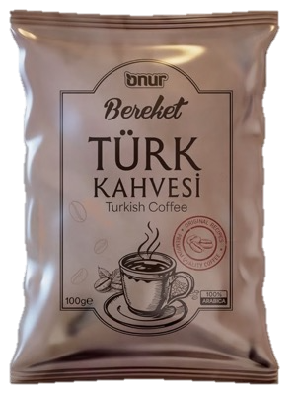
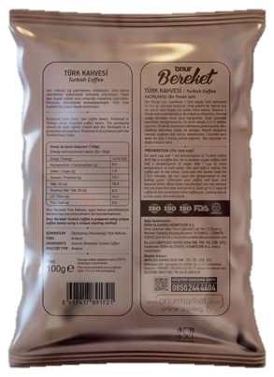
Our Onur Supermarkets – PL PRODUCT WORK
We produce
Bereket Turkish Coffee, the Onur Market Chain's own brand.

Slide 20


Local Market Zırhlı Gross – OUR SECTIONS
We are located in Zırhlı Market chain stores.

Slide 21
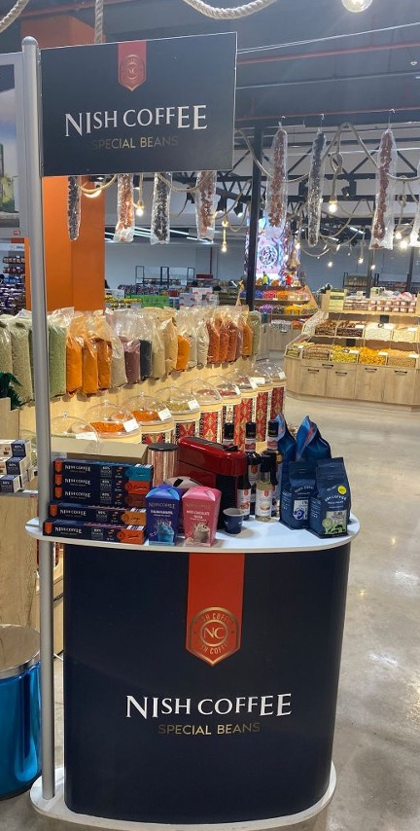
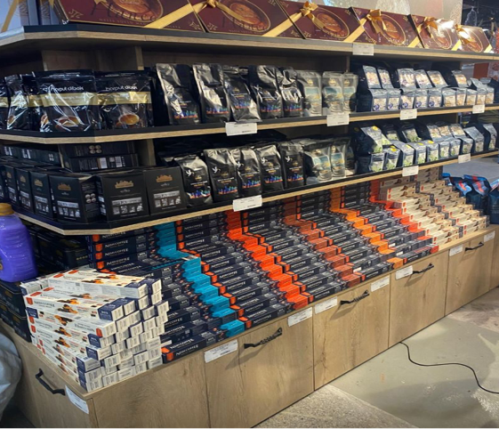
Local Market Zırhlı Gross – OUR SECTIONS
📍 We are located in all branches of Onur Market.

Slide 22
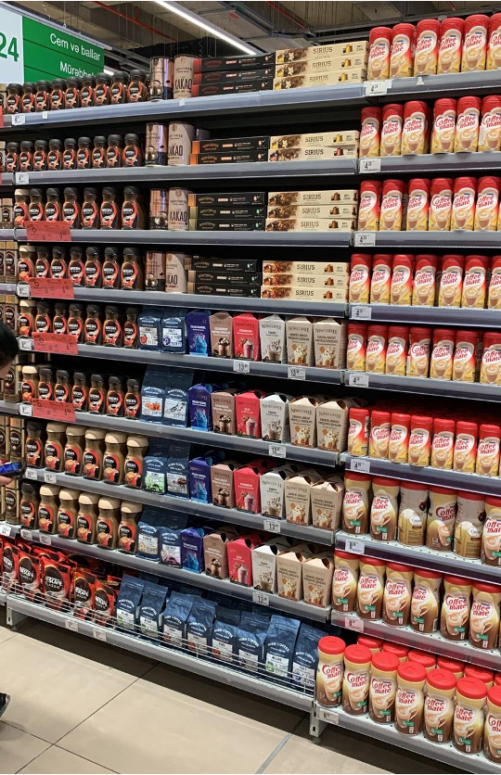
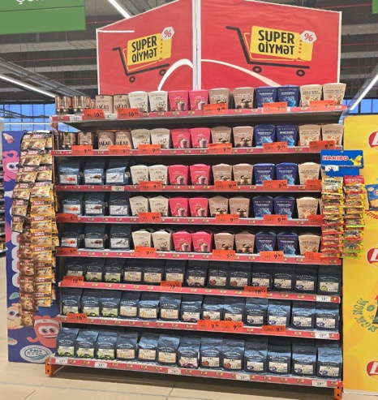

Azerbaijan Local Market Chain – Bravo Supermarkets
We are present in all 140 branches of Bravo Supermarket.

Slide 23
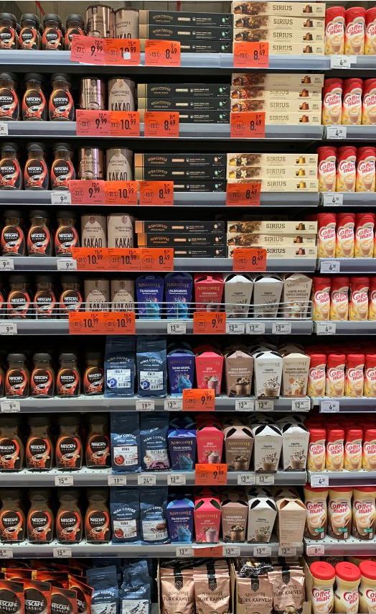
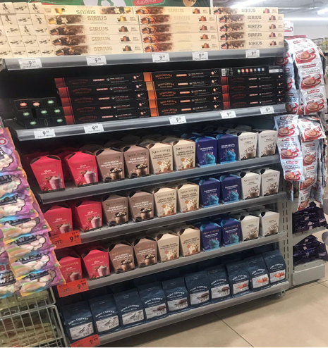
Azerbaijan Local Market Chain – Bravo Supermarkets
We are present in all 140 branches of Bravo Supermarket.

Slide 24
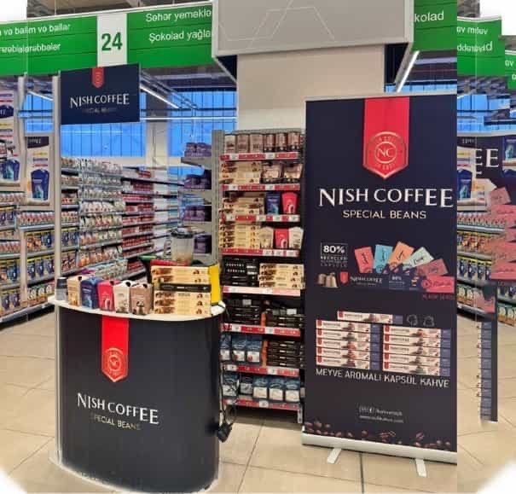
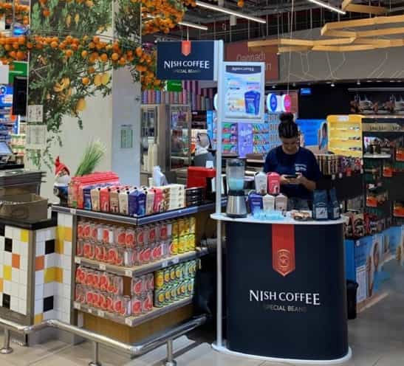
Azerbaijan Bravo Supermarkets – TASTING EVENTS VISUALS
We are increasing our store visits with our tasting events.

Slide 25
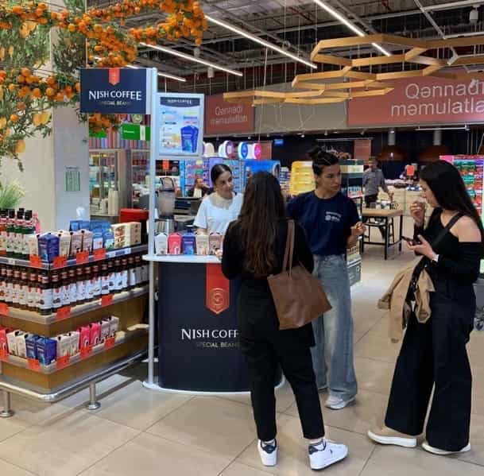
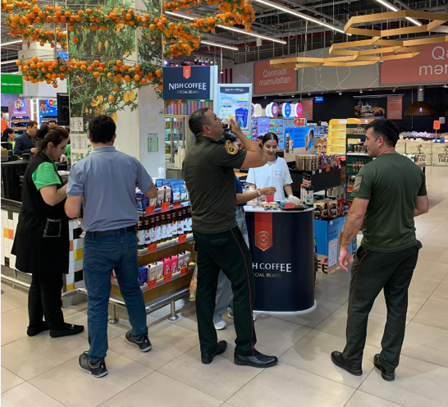
Azerbaijan Bravo Supermarkets – TASTING EVENTS VISUALS
We are increasing our store visits with our tasting events.

Slide 26
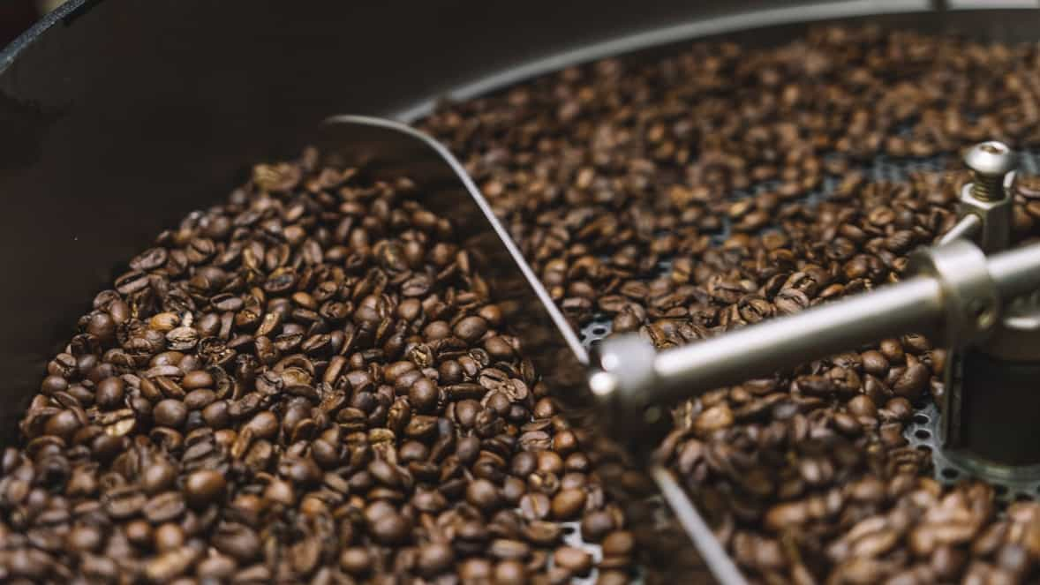



Battalgazi Mh. Saraypatı Sk. B Blok No: 2/23 Sultanbeyli - İstanbul – TÜRKİYE
0850 432 62 77 | info@nishkahve.com | www.nishkahve.com

